Slide 1


Bank Management System
Team Name: Alpha
Submitted by: 1.Name : Jannat Ara Simi
ID : 22201178
2. Name : Md. Sakib Hossaine
ID : 22201185
3. Name : Md Tabiur Rahman
ID : 22201171
4. Name : Mehedi Hasan Khan Riyad
ID : 22201172

Slide 2

Bank Management System
This project is a Bank Management System implemented using MySQL. It efficiently organizes and manages various aspects of a banking institution, such as customer details, accounts, loans, transactions, and credit cards. The system is designed to handle complex banking operations

Slide 3
Features
Branch and banker management
Customer account management
Loan processing and payment tracking
Transaction recording and analysis
Credit card issuance and management

Slide 4
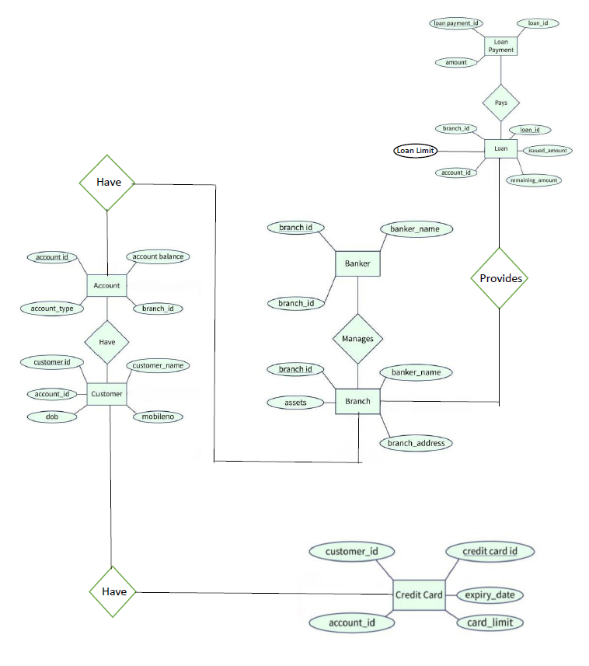
ER Diagram
Customer and Account:
Each customer can have multiple accounts with attributes like account_type, account_balance, and branch_id.
Customer details include customer_name, dob, and mobile_no.
Branch and Banker:
Branches are managed by bankers. Each branch has attributes like branch_id, branch_address, and assets.
Bankers are linked to branches using branch_id and manage operations.

Slide 5
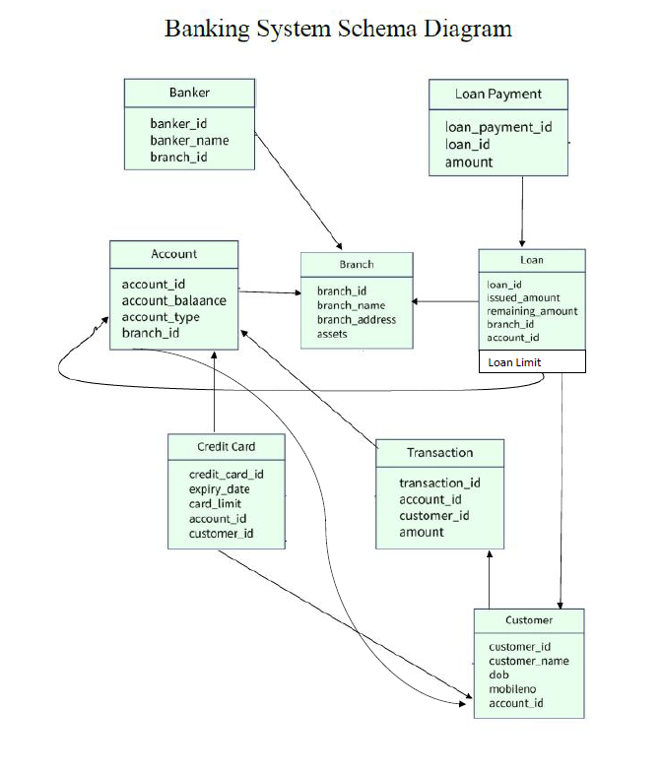
Schema Diagram
The relationships illustrate how these entities interact to manage banking operations like loans, accounts, and transactions.

Slide 6
Entities & Attributes
Entities:
1. Branch – Represents the physical location of the bank. Each branch offers services such as account creation, loan issuance, and credit card handling.
2. Banker – Employees assigned to manage customer relationships and oversee operations for specific branches.
3. Customer – Individuals who interact with the bank to open accounts, apply for loans, and manage their finances.
Attributes:
Branch
branch_id (Primary Key)
branch_name
address
Banker
banker_id (Primary Key)
branch_id (Foreign Key referencing branch)
banker_name

Slide 7
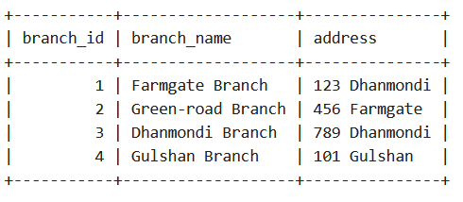
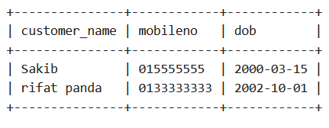
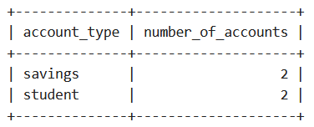
MY SQL QUERYS
1. Finding Branch table data.
SELECT * FROM branch;
2. Find all customers with a savings account. SELECT customer_name, mobileno, dob
FROM customer
INNER JOIN account ON
customer.account_id = account.account_id
WHERE account_type = 'savings';
3. Count the number of accounts per account type (student or savings).
SELECT account_type, COUNT(account_id)
AS number_of_accounts
GROUP BY account_type;
FROM account

Slide 8

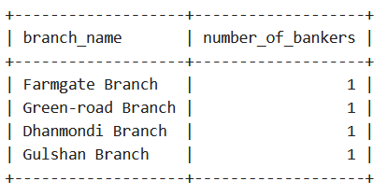
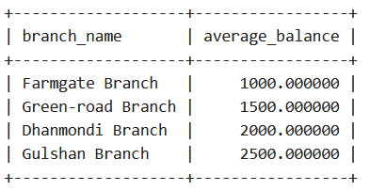
4. Show all bankers working at a specific branch
SELECT banker.banker_name
FROM banker
INNER JOIN branch ON banker.branch_id = branch.branch_id
WHERE branch.branch_name = 'Main Branch';
5. List all branches with the number of bankers working in each
SELECT branch.branch_name, COUNT(banker.banker_id)
AS number_of_bankers
FROM branch
LEFT JOIN banker ON branch.branch_id = banker.branch_id
GROUP BY branch.branch_name;
6. Calculate the average balance of accounts for each branch
SELECT branch.branch_name, AVG(account.balance) AS average_balance
FROM branch
INNER JOIN account ON branch.branch_id = account.branch_id
GROUP BY branch.branch_name;

Slide 9
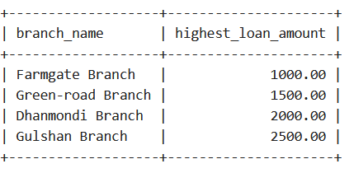
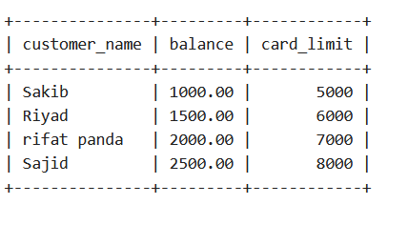

7. Retrieve the highest loan amount issued at each branch
SELECT branch.branch_name, MAX(loan.amount) AS highest_loan_amount
FROM loan
INNER JOIN branch ON loan.branch_id = branch.branch_id
GROUP BY branch.branch_name;
8. Find all credit card holders with their account balances and credit limits
SELECT customer.customer_name, account.balance,customer_credit_card.card_limit
FROM customer
INNER JOIN account ON customer.account_id = account.account_id
INNER JOIN customer_credit_card ON customer.customer_id
= customer_credit_card.customer_id;
9. "Find Loan Limit for Sakib" SELECT l.loan_limitFROM customer cJOIN account a ON c.account_id = a.account_idJOIN loan l ON a.account_id = l.account_idWHERE c.customer_name = 'rifat panda';

Slide 10

Corner Case

Slide 11
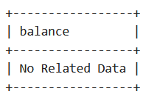
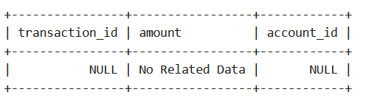
10. Retrieve the balances of all accounts with a balance greater than 5000. If no such accounts exist, display 'No Related Data
SELECT CAST(balance AS CHAR) AS balance
FROM account WHERE balance > 5000
UNION
SELECT 'No Related Data' WHERE NOT EXISTS (
SELECT 1 FROM account
WHERE balance > 5000 );
11. Find all transactions for a specific customer
SELECT transaction.transaction_id, transaction.amount, transaction.account_id
FROM transaction
INNER JOIN customer ON transaction.customer_id = customer.customer_id
WHERE customer.customer_name = 'nonexistent_customer'
UNION
SELECT NULL, 'No Related Data', NULL
WHERE NOT EXISTS ( SELECT 1 FROM transaction
INNER JOIN customer ON transaction.customer_id = customer.customer_id
WHERE customer.customer_name = 'nonexistent_customer' );

Slide 12


